Slide 1
Chapter 6
External Memory

Slide 2
Key points
Magnetic disks remain the most important component of external Memory
To achieve greater performance and higher availability, a popular scheme on servers and larger systems is the RAID disk technology.
RAID refers to family of techniques for using multiple disks as a parallel array of data storage devices , with redundancy built into compensate for disk failure.
Optical storage technology has become increasingly important in all types of computer systems. In addition to CDROM, writeable CD and DVD are becoming increasingly important.

Slide 3
External Memory
Magnetic Disk
RAID
Optical Memory
Magnetic Tape
CH05

Slide 4
Types of External Memory
Magnetic Disk
  RAID
  Removable
Optical
  CD-ROM
  CD-Writable (WORM)
  CD-R/W
  DVD
Magnetic Tape

Slide 5
Magnetic Disk
A disk is a circular platter constructed of nonmagnetic material called substrate coated with a magnetizable material.
Substrate consist of aluminum, plastic and recently of glass
magnetizable material: iron oxide
Range of packaging
  Floppy
  Winchester hard disk
  Removable hard disk

Slide 6
Magnetic Read and Write mechanisms
Data are recorded on and later retrieved from the disk via a conducting coil named the head.
The write mechanism: Electricity flowing through a coil (head) produces a magnetic field across the gap facing the head on the surface below and magnetizes with different patterns for positive and negative currents
The read mechanism: As magnetic field on the disk surface moves relative to coil; produces an electric current in the coil of the same polarity as the one already recorded.

Slide 7
Data Organization and Formatting
Concentric rings or tracks
  Gaps between tracks
  Reduce gap to increase capacity
  Same number of bits per track (variable packing density)
  Constant angular velocity
Tracks divided into sectors
Minimum block size is one sector
May have more than one sector per block

Slide 8
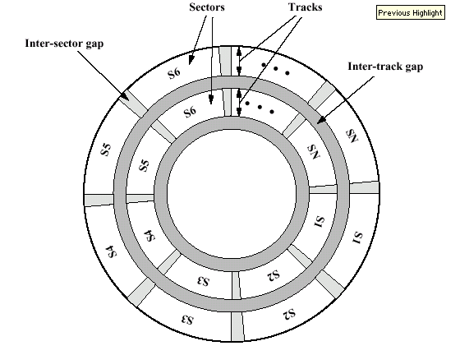
Disk Data Layout

Slide 9
Fixed/Movable Head Disk
Fixed head
  One read write head per track
  Heads mounted on fixed ridged arm
Movable head
  One read write head per side
  Mounted on a movable arm

Slide 10
Removable or Not //
Removable disk
  Can be removed from drive and replaced with another disk
  Provides unlimited storage capacity
  Easy data transfer between systems
Nonremovable disk
  Permanently mounted in the drive

Slide 11
Floppy Disk
8”, 5.25”, 3.5”
Small capacity
  Up to 1.44Mbyte (2.88M never popular)
Slow (disk rotate at 300 and 600 rpm, average delay 100/2 and 200/2 ms.)
Universal
Cheap

Slide 12
Winchester Hard Disk (1)
Developed by IBM in Winchester (USA)
Sealed unit that are almost free of contaminants, heads are designed to operate closer to the disk surface than conventional rigid disk heads.
One or more platters (disks)
Heads fly on boundary layer of air as disk spins (crash into disk!)
Very small head to disk gap
Getting more robust

Slide 13
Winchester Hard Disk (2)
Universal
Cheap
Fastest external storage (typically rotate 3600 rpm, newer faster, average rotational delay 8.3 ms.)
Getting larger all the time
  Multiple Gigabyte now usual

Slide 14
Removable Hard Disk
ZIP
  Cheap
  Very common
  Only 100M
JAZ
  Not cheap
  1G
L-120 (a: drive)
  Also reads 3.5” floppy
  Becoming more popular?

Slide 15
Finding Sectors
Must be able to identify start of track and sector
Format disk
  Additional information not available to user
  Marks tracks and sectors

Slide 16
ST506 format (old!)
Gap1
Id
Gap2
Data
Gap3
Gap1
Id
Gap2
Data
Gap3
Sync
Byte
Track
Sync
Byte
Head
Sector
CRC
Data
CRC
Foreground reading
  Find others

Slide 17
Physical Characteristics
Fixed (rare) or movable head
Removable or fixed disk
Single or double (usually) sided disk
Single or multiple platter
Head mechanism
  Contact (Floppy)
  Fixed gap
  Flying (Winchester)

Slide 18
Multiple Platter
One head per side
Heads are joined and aligned
Aligned tracks on each platter form cylinders
Data is striped by cylinder
  reduces head movement
  Increases speed (transfer rate)

Slide 19
Speed
Seek time
  Moving head to correct track
(Rotational) latency
  Waiting for data to rotate under head
Access time = Seek + Latency
Transfer rate T = (number of bytes to be transferred)/(rotation speed)/(number of bytes on a track) = b/(rN)
total access time T_{a} = T_{s} + 1/(2r) + b/(rN)

Slide 20
Sequential organization vs. random access e.g.
  e.g. a hard disk has average seek time of 4 ms, a transfer rate of 1 M byte/s, and 512 byte sectors with 500 sectors per track. Need to read a file consisting 2500 sectors for a total of 1.28 M bytes. What is the total time for the transfer?
Case 1: Sequential Organization (2500 sectors on 5 tracks x 500 sectors/tracks)
  Average seek time = 4 ms
  Rotational delay = 4 ms
  Read 500 sectors (one track) = 8 ms
  total time to read first track = 16 ms
  Total time = 16 ms + 4*(4 + 8) ms = 64 ms= 0.064 sec

Slide 21
Time required for random access on highly fragmented organization
Case 2: random access rather than sequential access
  Average seek time = 4 ms
  Rotational delay = 4 ms
  Read 1 sector = 8/500 = 0.016 ms
  time to read one sector = 8.016 ms
  Total time = 500 * 8.016 ms = 4.008 seconds
De-fragment you hard disk!

Slide 22
RAID
Redundant Array of Independent Disk
6 levels in common use
Not a hierarchy
RAID is Set of physical disks viewed as single logical drive by Operating system
Data are distributed across physical drives
Can use redundant capacity to store parity information

Slide 23
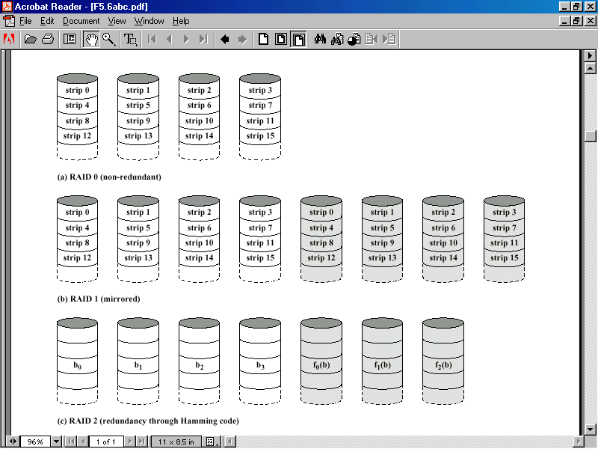
RAID Levels 0, 1, 2

Slide 24
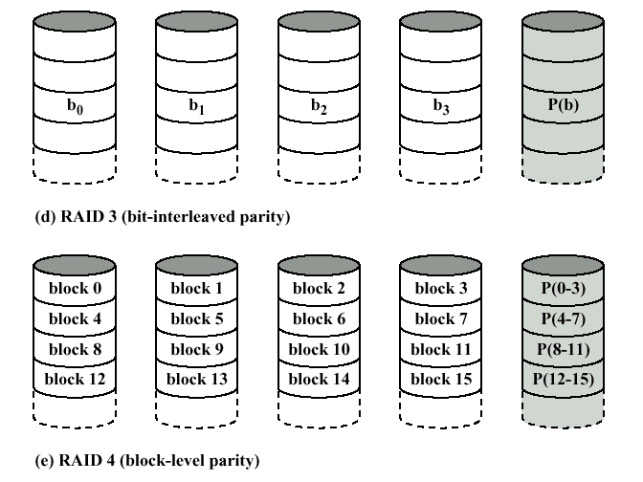
RAID Levels 3, 4

Slide 25
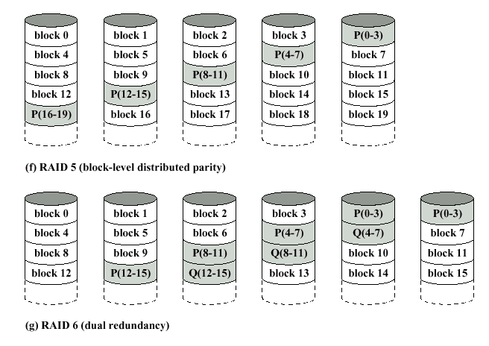
RAID Levels 5, 6

Slide 26
RAID 0
No redundancy
Data striped across all disks, the strips may be physical blocks, sectors or some other unit.
Round Robin striping
In an n disk array, the first n logical strips are physically stored as the first strip on each of the n disks, the second n strips are distributed as the second strips on each disk; and so on.
Increase speed
  Multiple data requests probably not on same disk
  Disks seek in parallel
  A set of data is likely to be striped across multiple disks

Slide 27
RAID 1
Mirrored Disks
Data is striped across disks
2 copies of each stripe on separate disks
A read request can be serviced by either of the two disks that contains the requested data.
A write request requires that both corresponding strips be updated, but this can be done in parallel.
Recovery is simple
  Swap faulty disk & re-mirror
  No down time
Expensive

Slide 28
RAID 2
Disks are synchronized
All member disks participate in the execution of every I/O request.
Very small stripes
  Often single byte/word
Error correction calculated across corresponding bits on disks
Multiple parity disks store Hamming code error correction in corresponding positions
Lots of redundancy (log of number of data disk)
  Expensive
  Not used

Slide 29
RAID 3
Similar to RAID 2 (small stripes)
Only one redundant disk, no matter how large the array
Simple parity bit for each set of corresponding bits
Data on failed drive can be reconstructed from surviving data and parity info
  Consider an array of five drives in which X₀ through X₃ contains data and X₄ is the parity disk. The parity for ith bit is:
  Suppose X₁ has failed then it can be recovered:
  This principle is true for RAID level 3 through 6
Return to full operation requires that the failed disk be replaced.
Very high transfer rates, performance suffers in a transaction oriented environment.

Slide 30
RAID 4
Each disk operates independently
Good for high I/O request rate, less suitable applications that require high data transfer rates.
Large stripes
Bit by bit parity calculated across stripes on each disk
Parity stored in the corresponding strips on parity disk
Each time a write occurs, the array management software must update user data and the corresponding parity bits. (Bottle neck)

Slide 31
RAID 5
Like RAID 4
Parity striped across all disks
Round robin allocation for parity stripe
Avoids RAID 4 bottleneck at parity disk
Commonly used in network servers

Slide 32
RAID 6
Two different parity calculations are carried out and
stored in separate blocks on different disks.
Able to regenerate data even if two disks containing user data fail

Slide 33
Optical Storage CD-ROM //
Originally for audio
650Mbytes giving over 70 minutes audio
Data stored as microscopic pits on the surface of the polycarbonate with a finely focused high intensity laser to create master disk. The master is used to make a die to stamp out copies onto polycarbonate.
The pitted surface is coated with highly reflective coat, usually aluminum or gold. The shiny surface is protected against dust and scratches by a top coat of clear acrylic. A label can be silk screened onto the acrylic.
Read by reflecting laser, if the laser beam falls on a pit, the light scatters and a low intensity is reflected back to the source. The areas between pits are called lands, which reflects back at higher density. The change between pits and lands is detected by a photo sensor. The beginning or end of pit represents a 1; when no change in elevation occurs between intervals, a 0 is recorded.

Slide 34
Constant packing density
Constant linear velocity
Disk contains a single spiral track, beginning near the centre and spiraling out to the outer edge of the disk. Sectors near the outside of the disk are the same length as those near the inside. The pits are read by the laser at a constant linear velocity (CLV).

Slide 35
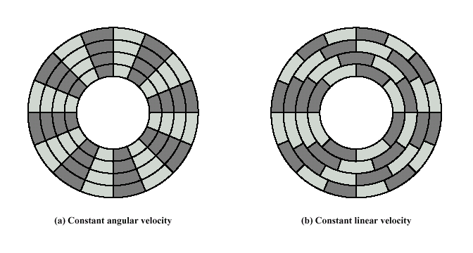
Constant Angular Velocity vs. Constant Linear Velocity

Slide 36
CD-ROM Drive Speeds
Audio is single speed
  Constant linear velocity
  1.2 ms⁻¹
  Track (spiral) is 5.27km long
  Gives 4391 seconds = 73.2 minutes
  Date 176.4 K bytes/s total capacity 774.57 M Bytes
Other speeds are quoted as multiples
e.g. 24x ~= 4 M Bytes/s (data transfer rate)
The quoted figure is the maximum the drive can achieve
Data on CD ROM are organized as sequence of blocks

Slide 37
CD-ROM Format
00
FF
x 10
00
Layered
ECC
Sec
Mode
Data
Min
Sector
12 byte
Sync
4 byte
Id
2048 byte
288 byte
2352 byte
Mode 0=blank data field
Mode 1=2048 byte data+error correction
Mode 2=2336 byte data

Slide 38
CD-ROM for & against
Large capacity (?)
Easy to mass produce
Removable
Robust
Expensive for small runs
Slow
Read only

Slide 39
Other Optical Storage
CD-Writable
  WORM
  Now affordable
  Compatible with CD-ROM drives
  For CD recordable the medium includes a dye layer. The dye is used to change reflectivity and is activated by a high intensity laser.
CD-RW
  Erasable
  Getting cheaper
  Mostly CD-ROM drive compatible.
  The disk uses material which can change phase with two different reflectivities. One is an amorphous state, in which molecules exhibit a random orientation and which reflects light poorly and the other is crystalline state, which has smooth surface that reflects light well.

Slide 40
DVD - what’s in a name?
Digital Video Disk
  Used to indicate a player for movies
    Only plays video disks
Digital Versatile Disk
  Used to indicate a computer drive
    Will read computer disks and play video disks

Slide 41
DVD - technology
Multi-layer, bits are packed more closely than CD
The spacing between loops 0.74 µm and distance between pits 0.4 µm
Very high capacity (4.7G per layer)
dual-layer (single-sided ?) hold 8.5 Gbytes ~> 4hr movie
Full length movie on single disk
  Using MPEG compression
Finally standardized
Movies carry regional coding
Players only play correct region films

Slide 42
DVD - Writable
Loads of trouble with standards
First generation DVD drives may not read first generation DVD-W disks
First generation DVD drives may not read CD-RW disks; now it reads

Slide 43
Magnetic Tape
Serial access
Slow
Very cheap
Backup and archive
Data on the tape are structured as a number of parallel tracks.
Parallel recording records byte or words at a time on parallel tracks.
Serial recording records data as sequence of bits along the track.
Data are read and written in contiguous blocks. Blocks on the tape are separated by interrecord gaps.
The tape is formatted to assist in locating physical records.
Serpentine recording: the first set of bits is recorded along the whole length of the tape. When the end is reached, the heads are repositioned to record a new track in opposite direction

Slide 44
Digital Audio Tape (DAT)
Uses rotating head (like video)
High capacity on small tape
  4Gbyte uncompressed
  8Gbyte compressed
Backup of PC/network servers

